Slide 1
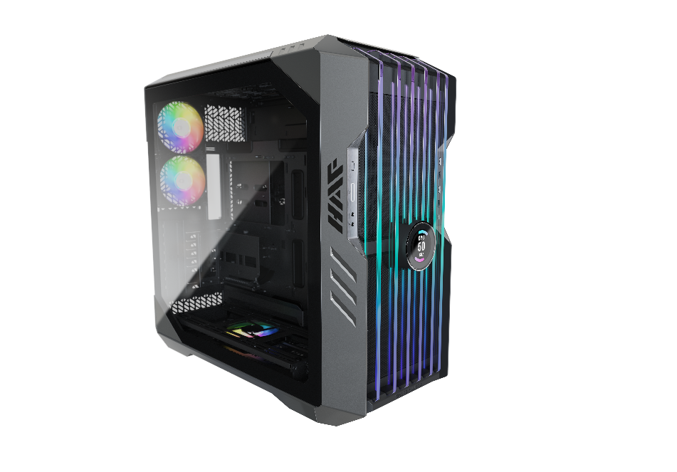
Air To The Throne
HAF 700 EVO
H700E-IGNN-S00
Created Only for the Best
To unlock their true potential, cooling components must work, not individually, but together as an ecosystem. The right case can do that for you.
HAF 700 EVO unveils a new era of thermal efficiency through unique features designed to transcend the standards of contemporary cooling solutions. Rediscover PC DIY: a form of entertainment, a polished skillset, an exquisite art form, and a way of living.
Product Name |  |  | HAF700 EVO
Product Number |  |  | H700E-IGNN-S00
Exterior Color |  |  | Titanium Grey
Materials | Exterior |  | Mesh, Steel, Plastic
 | Left Side Panel |  | Tempered Glass, Steel
Dimensions (L x W x H) | Body size |  | 556 x 279 x540 mm
 | incl. Protrusions |  | 666 x 291 x 626 mm
Motherboard Support |  |  | Mini-ITX, Micro-ATX, ATX, E-ATX, SSI-CEB, SSI-EEB
Expansion Slots |  |  | 8
Drive Bays |  | 5.25“ ODD | N/A
 |  | 3.5” / 2.5” Combo | 12
 |  | 2.5” SSD | 12
I/O Panel |  | USB Ports | 1 x USB 3.2 gen 2 Type C 4 x USB 3.2 gen 1 (3.0)
 |  | Audio In / Out | 1 x 3.5mm 4poles Audio Jack 1 x 3.5mm Mic Jack
 |  | Other | 1 x LED Controller A1 (ARGB Gen2) 1 x ARGB/PWM Hub
Pre-installed Fan(s) |  | Front | 2x SickleFlow PWM Performance Ed. 200mm
 |  | Rear | 2x SickleFlow PWM ARGB 120mm
 |  | Bottom | 1x SickleFlow PWM ARGB 120mm
Fan Support |  | Top | 2 x 200mm, 3 x 140mm, 6 x 120mm (Remove 480mm bracket)
 |  | Front | 2 x 200mm, 3x 120/140mm
 |  | Rear | 2x 120mm
 |  | Bottom | 3 x 120 / 3 x 140mm
 |  | Side mount | 4 x 120 / 3 x 140mm
Radiator Support |  | Top | Up to 2 x 360mm / 1 x 420mm
 |  | Front | Up to 420/360mm
 |  | Rear | Up to 240mm
 |  | Bottom | Up to 420/360mm
 |  | Side mount | Up to 480/420mm
Clearances |  | CPU Cooler | 166mm / 6.53 inch
 |  | Power Supply | 200mm / 7.87 inch
 |  | Graphics Card | 490mm / 19.29 inch
Cable Routing |  | Behind MB Tray | 90~101mm
Additional Included Accessories |  |  | Universal Graphics Card Holder Kit V2
Dust Filters |  |  | Front, Bottom, Side
Power Supply Support |  |  | Bottom Mount, ATX
Warranty |  |  | 2 Years
* For regular 30mm thick radiators, for thicker please reference compatibility sheet.
The Pinnacle of Cooler Master’s HAF Legacy –
Debuted in 2008, HAF has long been synonymous with exquisite performance and DIY freedom. HAF 700 EVO recreates not only HAF’s renowned thermal caliber but also the essence of its long-lived legacy.
The HAF Standard In Cooling –
HAF 700 EVO comes carefully engineered to maintain top market thermal performance and minimal noise levels at stock configuration. From the edge-lit ARGB tempered glass Intake Blades to boundless freedom in air and water cooling versatility, create your own system that runs as performant as it looks. Fancy eighteen 120mm fans? Dual 360 radiators? 480mm radiators? Take your pick, and make it yours.
Built-In, Real Time Stats Monitoring –
Monitor system stats in real time or showcase your personality on Iris, your built-in LCD assistant. Immerse yourself in full range customization of Iris’s display and ARGB Gen2 elements via MasterPlus+, and bring to life vastly diverse setups, unique in aesthetics and function.
A Decade of HAF Design, Revolutionized –
Minutes saved installing your system is worth millions in creative freedom. HAF 700 EVO’s state-of-the-art extensive tool-less design challenges the minimum number of screws required to complete a system. From the GPU, PSU to HDDs…install each detail with your bare hands and feel the heartbeat of an ever-evolving legacy.
EAN code | 4719512126271, 6928968315469(CN)
UPC code | 884102098598
Net weight | 24.70 kg
Gross weight | 29.40 kg
Carton dimension (L x W x H) | 780 x 399 x 725 mm
Cont. | W/ Pallet | Carton/ Pallet | W/O Pallet
20’ | 77 | 7 | 123
40’ | 154 | 7 | 249
40 HQ | 198 | 9 | 294

Slide 2
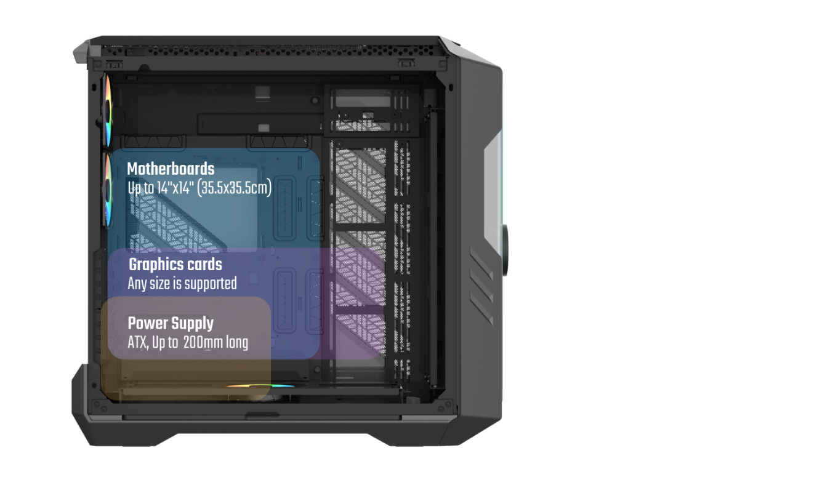
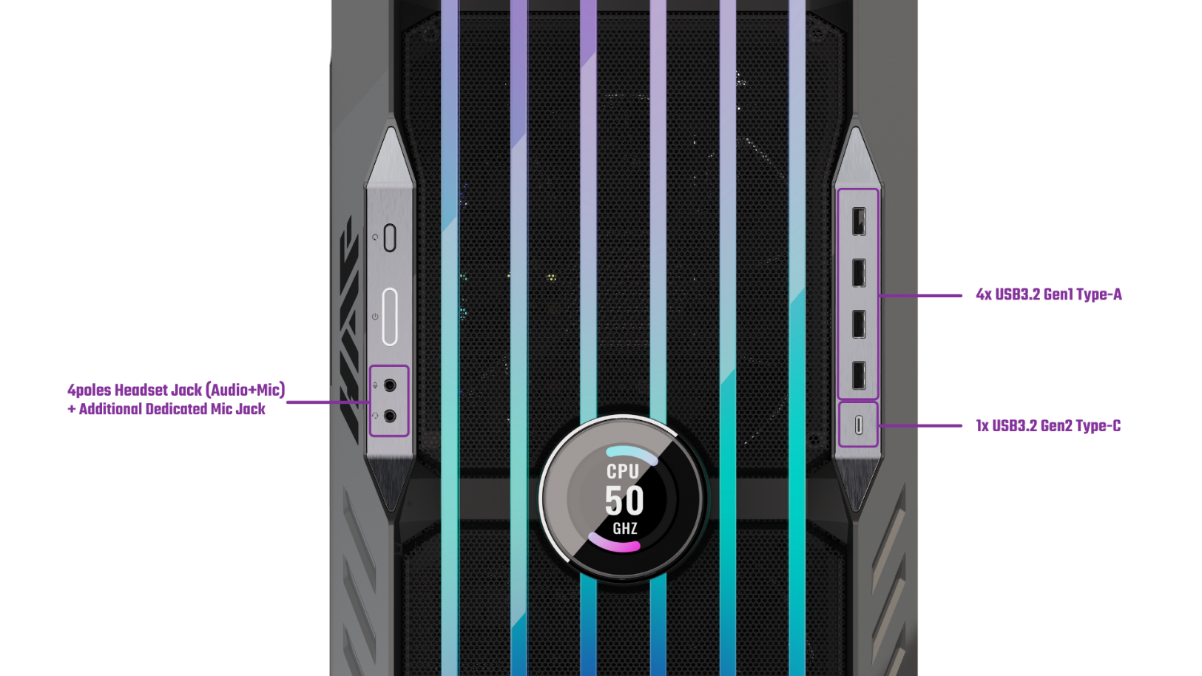
HARDWARE SUPPORT & CONNECTIVITY
The HAF700 EVO truly has no limits when it comes to hardware support.
Drawing inspiration from our ever-growing community of enthusiasts, the HAF 700 EVO is capable of housing up to EATX motherboards such as the Dominus Extreme, as well as any sized graphics cards in both horizontal and vertical orientations.
Users can enjoy direct side intake and support for power supplies of up to 200mm, and well as unparalleled number of options for installing disks, pumps and radiators.

Slide 3
Unmatched Cooling Options
Mammoth Radiator Support
HAF 700 EVO provides users unparalleled options for out-of-the-box cooling support. Users may pick and choose between installing a selection of radiator sizes in various mounting locations: 480mm (side panel), 360mm (front panel, bottom panel, or up to dual radiators on the top panel), or 240mm (rear panel).
Rotatable Radiator Bracket
HAF 700 EVO boasts two rotatable fan/radiator brackets. These brackets are fully modular and can be installed in multiple positions for complex setups. Users may choose one of the two to rotate, showcasing their radiator at unique angles.
Tool-less Removable Top Panel
Exclusive tool-less removable top panel design allows for easy removal of top and side panels. Cooling components such as fans and radiators can be effortlessly installed, accessed and maintained.

Slide 4
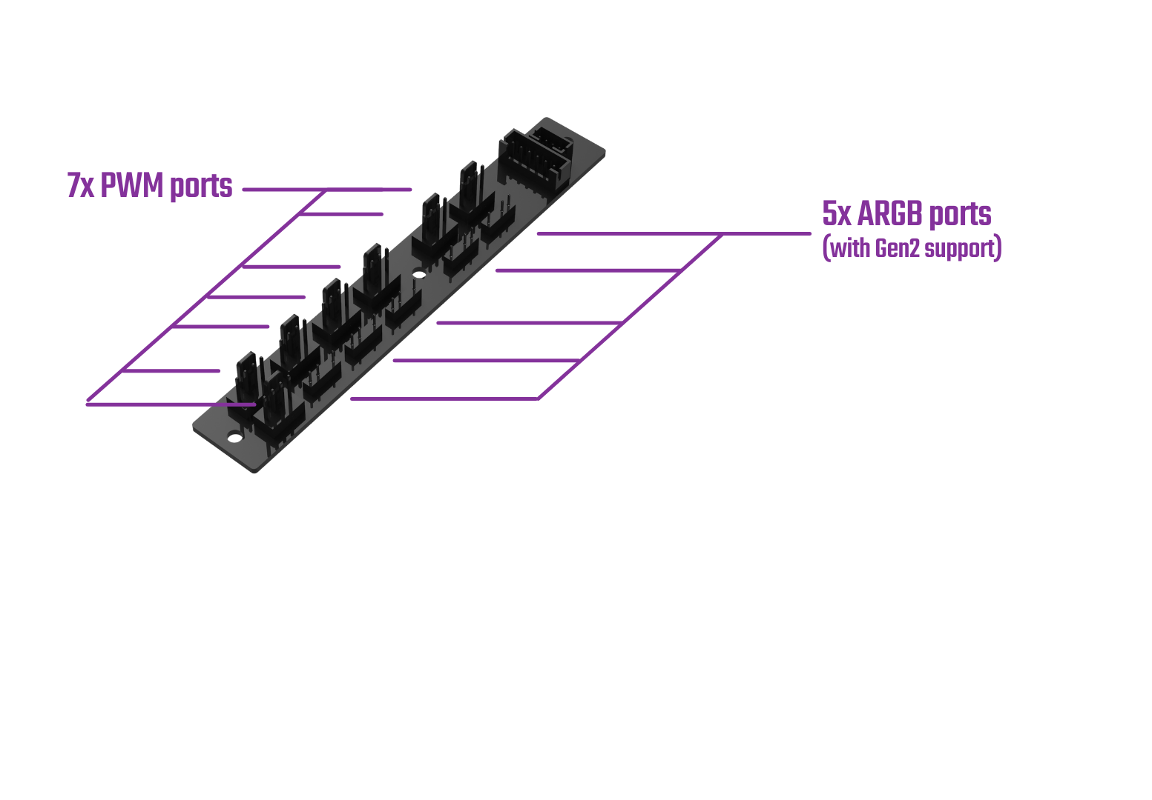
Airflow Performance Details
200mm SickleFlow PWM Performance Edition
HAF 700 EVO comes with dual 200mm Sickleflow PWM fans tailored to maximize the performance potential of installed components. Fan curves can be customized to keep temperatures and noise levels low, even in extreme overclocking scenarios.
Integrated 7x PWM & 5x ARGB Hub
This chassis features a fully integrated PWM/ARGB Hub that allows for effortless cable management and control over multiple fans and ARGB devices. The Hub is fully compatible with ARGB Gen2 devices, allowing users to customize fan speeds and ARGB effects in depth according to their system needs or personal preference.

Slide 5
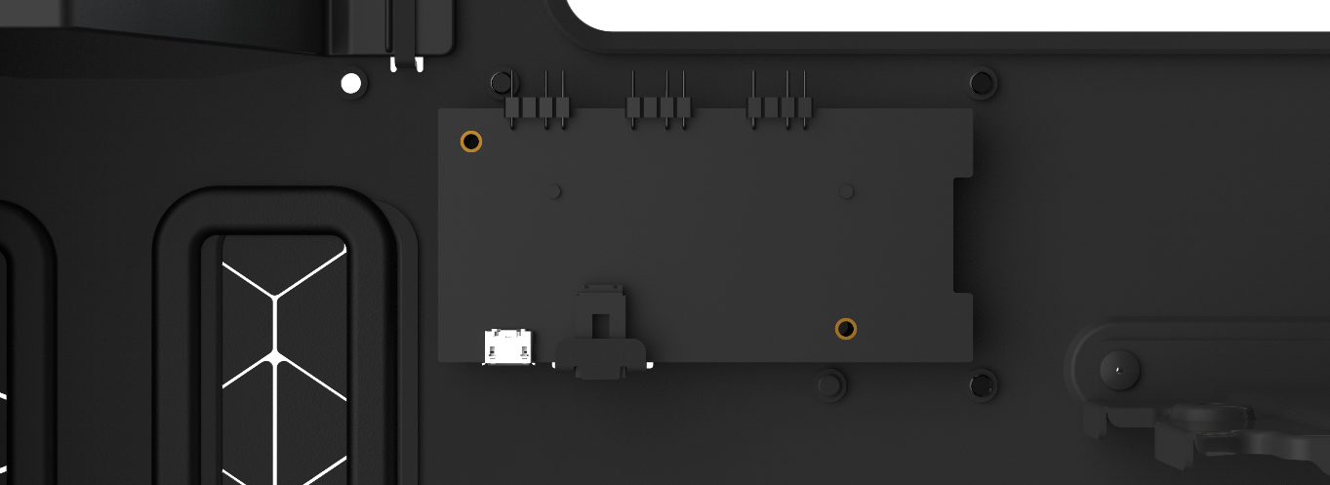
Digital Features
ARGB Gen2 Ready, Controller Included
ARGB Gen2 devices allow software to automatically detect the arrangement and number of LEDs in each ARGB device. Thus, ARGB Gen 2 devices make full range customization possible as each LED can be independently controlled.
Each device will be independently recognized, regardless of the number of devices connected to a single ARGB port, allowing users to create complex lighting setups with minimal wiring and configuration.
Unlike some ARGB Gen1 devices which sacrifice hardware compatibility for customization flexibility, Cooler Master’s ARGB Gen2 devices remain fully compatible with third party devices, granting users the freedom to mix and match multiple devices from different ecosystems.
Iris: Customizable LCD Assistant
MasterPlus+ Implementation
The front panel features Iris, an LCD assistant which can be set to display system/game statistics, or any video, and image of your heart’s desire.
In depth customization such as screen orientation, color, text and animation speed is also made possible via software.
HAF 700 EVO comes equipped with a software suite in MasterPlus+, facilitating user-friendly management and customization of ARGB Gen2 LEDs and Iris.
Connect the integrated controller to the system in order to automatically activate the software suite in MasterPlus+.

Slide 6
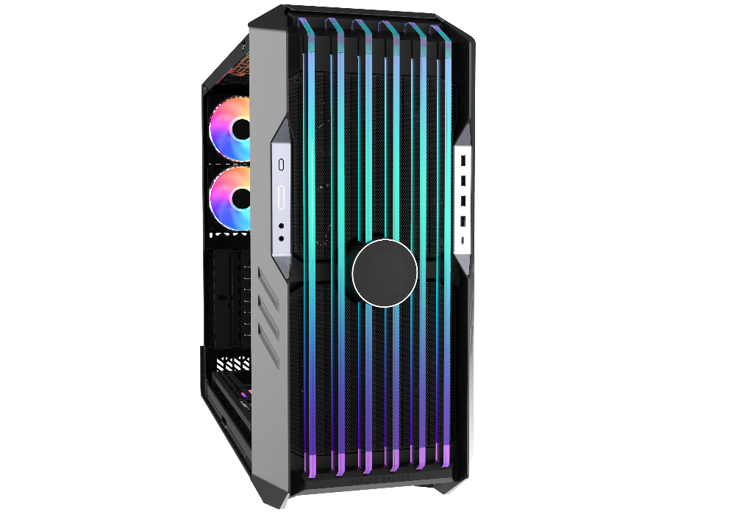
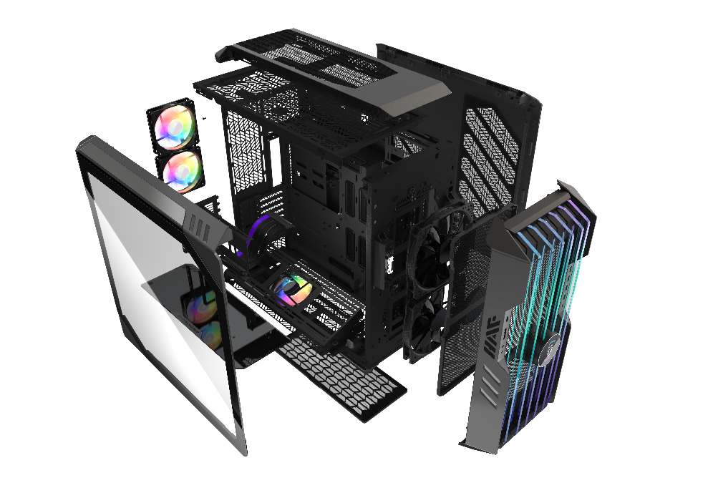
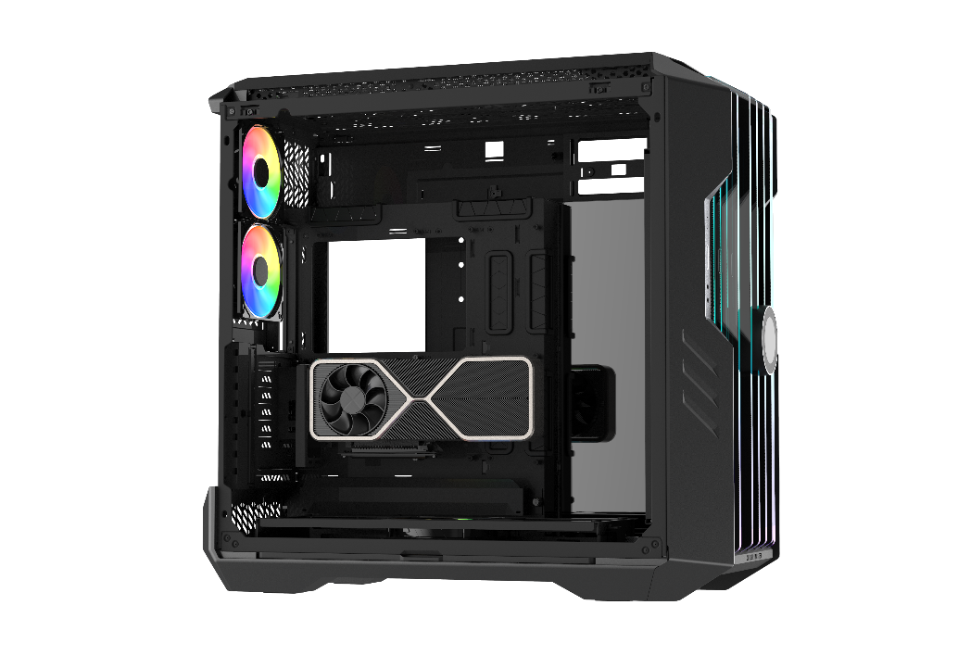
Unique Body Features
Edge Lit Intake Blades
Staying true to its HAF identity, HAF 700 EVO’s breathable tempered glass front panel allows for maximum airflow and performance, so even the most power-hungry components can shine without being held back.
Thick, robust, ARGB tempered glass Intake Blades create a unique, futuristic lighting effect that immediately makes your PC the star of any gaming room.
Multi Chamber Layout
The body of the HAF 700 EVO is organized into multiple sectors, including a cooling chamber, cable management gutter, dedicated swiveling hard drive cage, as well as a power supply slot, allowing for complex yet tidy builds. Furthermore, by segregating non heat sensitive components, heat dissipation can be optimized and targeted towards heat sensitive components at an overall higher efficiency.
Vertical GPU Holder With PCIe 4.0 Riser Cable
A vertical graphics card holder comes included with HAF 700 EVO to grant users the flexibility of choice in aesthetic display and airflow performance. An ultra durable PCIe 4.0 riser cable is utilized so data transfer speeds need not be sacrificed.

Slide 7
Tool-less Installation
Tool-less Vertical GPU Mounting (Patent Pending)
Tool-less PSU Mount
The back panel implements a patent pending clamping mechanism that allows users to install, remove, and upgrade graphics cards without the need to use any tools.
This custom design locks the GPU firmly in place in case of transportation. Safety pins prevent the GPU from falling and being damaged when the clamp is opened.
HAF 700 EVO implements a never-seen-before way of securing the power supply without the need to fiddle with tools. To install, simply slide the power supply in place and secure it with the two included thumbscrews on the rear end of the case.
Tool-less HDD Cage
Tool-less Multifunction Bracket
(HDDs / SSDs / Pumps / Reservoirs)
The rear chambers includes a tool-less, swiveling drive cage that allows users to quickly access, maintain and swap hard drives with ease.
HAF700 EVO features versatile brackets that can be used to mount an SSD, HDD, or a pump/reservoir for liquid cooling. Brackets can be placed in multiple positions inside the case, including the cooling brackets and the open side of the motherboard tray.

Slide 8
Bonus Feature
Infinity Mirror
…Because what’s the point of owning a flagship case without having a bit of fun?
The Infinity Mirror allows you to turn extra clearance in the build into your personal Hall of Fame.
If you don’t have a prized collectable that you would like to showcase (yet!), the Infinity Mirror can also be used to highlight various angles of internal components that would otherwise remain hidden. When placed on the opposing side of the TG side panel, ARGB lights also become enhanced with a infinity effect, creating trippy, cool-looking builds.

